Slide 1
SQL Project
ANKUSH PATEL

Slide 2
Creating table IPL_BALL
Query-
create table IPL_BALL (
ID int,inning int,Over int,Ball int, Batsman varchar,Non_Striker varchar,Bowler varchar,Batsman_Runs int,Extra_runs int,Total_runs int,Is_Wicket int,Dismissal_Kind varchar,Player_Dismissed varchar,Fielder varchar,Extra_Type varchar,Batting_Team varchar,Bowling_Team varchar);

Slide 3
Importing Data for IPL_BALL table
Query-
copy IPL_BALL from 'C:\ProgramFiles\PostgreSQL\15\data\Data_copy\Database\IPL_Ball.csv' delimiter ',' CSV Header;

Slide 4
Creating Table IPL_Matches
Query-
create table ipl_matches(
id int,city varchar,date varchar,playes_of_match varchar,venue varchar,neutral_venue int,team1 varchar,team2 varchar,toss_winner varchar,toss_decision varchar,winner varchar,result varchar,result_margin int,eliminator varchar,method varchar,umpire1 varchar,umpire2 varchar);

Slide 5
Importing Data for IPL_Matches
Query-
copy ipl_matches from 'C:\ProgramFiles\PostgreSQL\15\data\Data_copy\Database\IPL_matches.csv' delimiter ',' CSV Header;

Slide 6
Question-Your first priority is to get 2-3 players with high S.R who have faced at least 500 balls.And to do that you have to make a list of 10 players you want to bid in the auction so that when you try to grab them in auction you should not pay the amount greater than you have in the purse for a particular player
Query-
select batsman,sum(batsman_runs) as runs,count(ball) as ball_faced,
(sum(batsman_runs)*1.0/count(ball))*100 as strike_rate
from ipl_ball
where extra_type != 'wides'
group by batsman
having count(ball)>=500
order by strike_rate desc
limit 10;

Slide 7
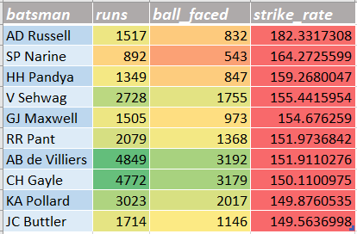
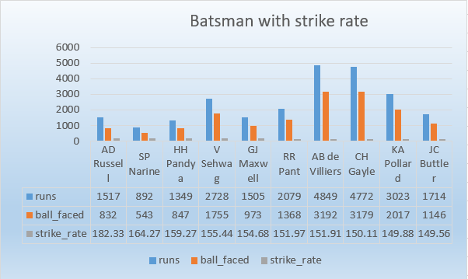
Output

Slide 8
Question-Now you need to get 2-3 players with good Average who have played more than 2 ipl seasons. And to do that you have to make a list of 10 players you want to bid in the auction so that when you try to grab them in auction you should not pay the amount greater than you have in the purse for a particular player.
Query-
select a.batsman,sum(a.is_wicket) as dismissed,sum(a.batsman_runs) as total_runs,
count(distinct(extract(year from b.date))) as season,sum(a.batsman_runs)*1.0/sum(a.is_wicket) as average
from ipl_ball as a
inner join
ipl_matches as b
on a.id=b.id
group by a.batsman
having sum(a.is_wicket)>0 and count(distinct(extract(year from b.date)))>2
order by average desc
limit 10;

Slide 9
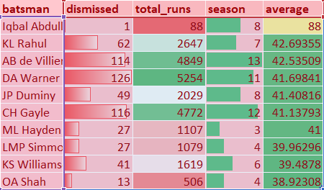
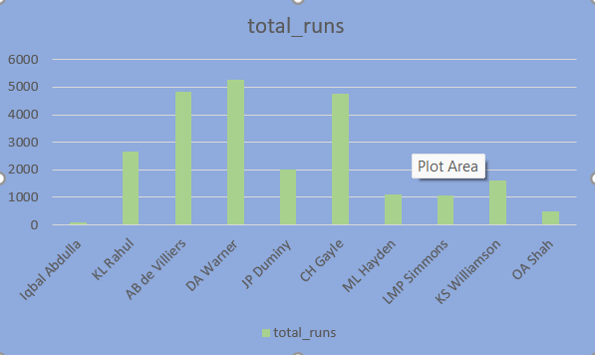
Output

Slide 10
Question-Now you need to get 2-3 Hard-hitting players who have scored most runs in boundaries and have played more the 2 ipl season. To do that you have to make a list of 10 players you want to bid in the auction so that when you try to grab them in auction you should not pay the amount greater than you have in the purse for a particular player.
Query-
select a.batsman,sum(a.batsman_runs) as total_runs,b.boundary_runs*100/sum(a.batsman_runs) as bo_percent,b.boundary_runs
from ipl_ball as a
inner join
(select a.batsman,sum(a.batsman_runs) as boundary_runs from ipl_ball as a
where a.batsman_runs=4 or a.batsman_runs=6
group by a.batsman) as b
on a.batsman=b.batsman
group by a.batsman,b.boundary_runs
order by total_runs desc
Limit 10;

Slide 11
Problem in last Question
Sir for hard hitter batsman question I have reached till here now I want to add restriction for 2 IPL season.
For that I need to access data from IPL_matches table. But sir I don't know how can I reach there that’s why I am adding only half solution.

Slide 12
Question-Your first priority is to get 2-3 bowlers with good economy who have bowled at least 500 balls in IPL so far.To do that you have to make a list of 10 players you want to bid in the auction so that when you try to grab them in auction you should not pay the amount greater than you have in the purse for a particular player.
Query-
select a.bowler as bowler,sum(a.total_runs) as runs_conceded,(count(bowler))/6.0 as over_bowled,
(sum(a.total_runs)/count(bowler)/6.0) as economy,count(a.ball) as ball
from ipl_ball as a
group by a.bowler
having(count(ball))>=500
order by economy
limit 10;

Slide 13
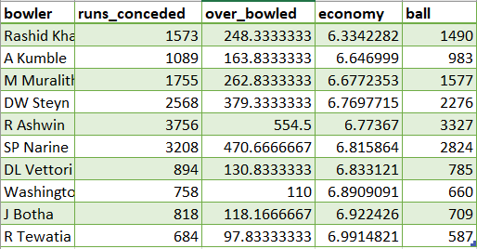
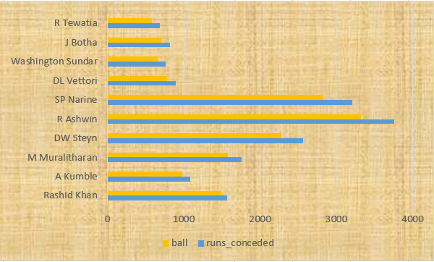
Output

Slide 14
Question- Now you need to get 2-3 bowlers with the best strike rate and who have bowled at least 500 balls in IPL so far.To do that you have to make a list of 10 players you want to bid in the auction so that when you try to grab them in auction you should not pay the amount greater than you have in the purse for a particular player?
select a.bowler,count(a.bowler) as balls,b.wickets,count(a.bowler)*1.0/b.wickets as strike_rate
from ipl_ball as a
inner join
(select a.bowler,count(a.is_wicket) as wickets from ipl_ball as a
where dismissal_kind in ('lbw','caught','bowled','hit wicket','stumped')
group by a.bowler) as b
on a.bowler=b.bowler
group by a.bowler,b.wickets
having count(a.bowler)>=500
order by strike_rate
limit 10;

Slide 15
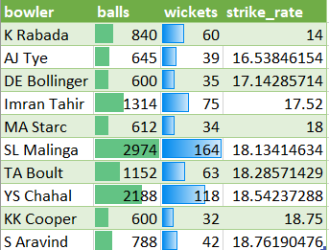
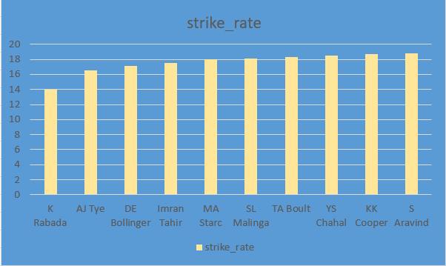
Output

Slide 16
Question-Now you need to get 2-3 All_rounders with the best batting as well as bowling strike rate and who have faced at least 500 balls in IPL so far and have bowled minimum 300 balls.To do that you have to make a list of 10 players you want to bid in the auction so that when you try to grab them in auction you should not pay the amount greater than you have in the purse for a particular player.
Query-
select a.batsman,(sum(a.batsman_runs)*1.0/count(a.bowler))*100 as batting_strike_rate,b.bowling_strike_rate from ipl_ball as a
inner join
(select a.bowler,count(a.bowler)*1.0/sum(a.is_wicket) as bowling_strike_rate from ipl_ball as a
where a.dismissal_kind not in ('run out','retired hurt','obstructing the field')
group by a.bowler
having count(a.bowler)>300) as b
on a.batsman=b.bowler
where extra_type not in ('wide')
group by a.batsman,b.bowling_strike_rate
having count(a.bowler)>500
order by batting_strike_rate desc
limit 10;

Slide 17
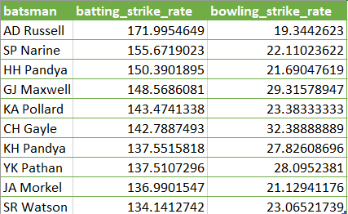
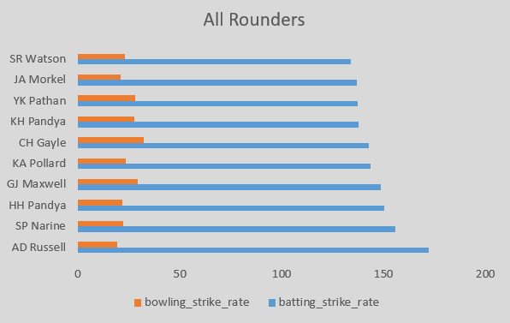
Output

Slide 18
Wicketkeeper
select a.batsman,sum(a.batsman_runs)*100.0/count(a.bowler) as sr,b.stumping
from ipl_ball as a
inner join
(select a.batsman,count(a.dismissal_kind) as stumping from ipl_ball as a
where dismissal_kind='stumped'
group by a.batsman) as b
on a.batsman=b.batsman
group by a.batsman,b.stumping
order by b.stumping desc
limit 10;

Slide 19
Explanation for wicketkeeper
I have chosen them based on number of stumping they have done because for a wicketkeeper it is important that how it often they can benefit their team when batsman do the mistake and batsman do these mistakes when he try to play big shots, having their wicket can be a turning point for the match.
I have also chosen them, that how fast they can score runs in minimum balls.
I did not take the criteria for bowling because it is very rare that they come for bowling and it is not much important in t-20 cricket for wicketkeeper point of view.

Slide 20
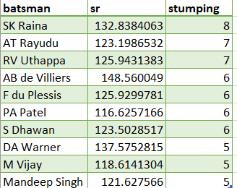
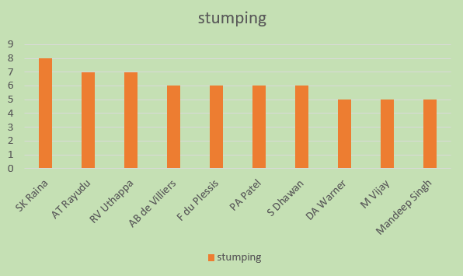
Output

Slide 21
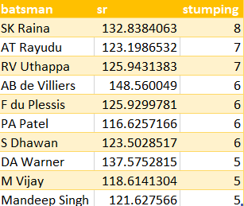
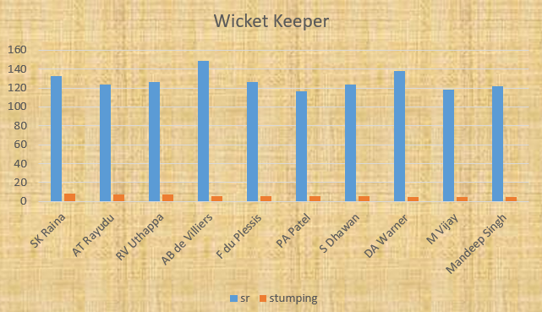
Output

Slide 22
Additional Questions
Creating Table Deliveries from ipl_ball table-
create table deliveries as select*from ipl_matches;
Creating table Matches from ipl_matches-
create table matches as select*from ipl_matches;

Slide 23
Answer 1
select count(distinct(city)) as city_counts
from ipl_matches;

Slide 24
Answer 2
create table deliveries_v02 as
(select *,
case when total_runs>=4 then 'boundary'
when total_runs=0 then 'dot'
else 'other' end as ball_result
from deliveries);

Slide 25
Answer 3
select count(ball_result) as no_of_boundaries,
(select count(ball_result) as dot from deliveries_v02
where ball_result='dot') as dot_balls
from deliveries_v02
where ball_result='boundary';

Slide 26
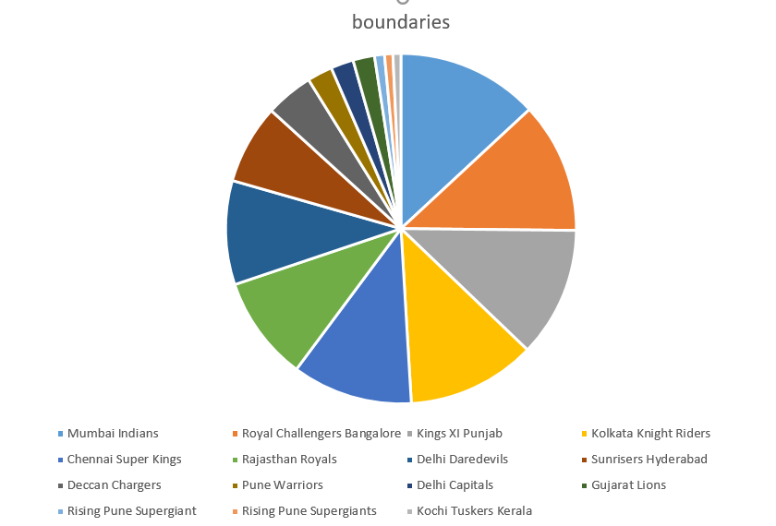
Answer 4
select batting_team,count(ball_result) as boundaries
from deliveries_v02
where ball_result='boundary'
group by batting_team
order by boundaries desc;

Slide 27
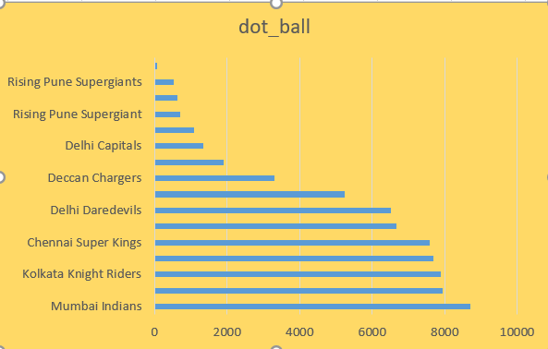
Answer 5
select bowling_team,count(ball_result) as dot_ball
from deliveries_v02
where ball_result='dot'
group by bowling_team
order by dot_ball desc;

Slide 28
Answer 6
select count(dismissal_kind) as number_of_dismissal_kind
from deliveries_v02
where dismissal_kind != 'NA';

Slide 29
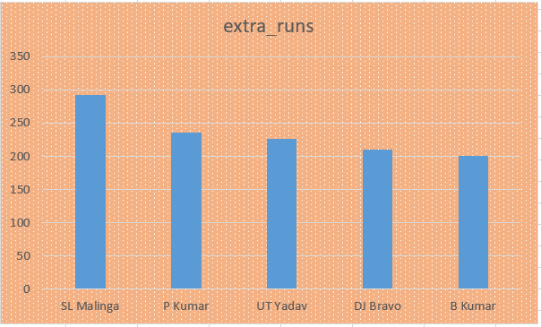
Answer 7
select bowler,sum(extra_runs) as extra_runs
from deliveries
group by bowler
order by extra_runs desc
limit 5;

Slide 30
Answer 8
create table deliveries_v03 as (select a.*,b.venue,b.match_date from deliveries_v02 as a
inner join
(select id,venue,date as match_date from ipl_matches) as b
on a.id=b.id);

Slide 31
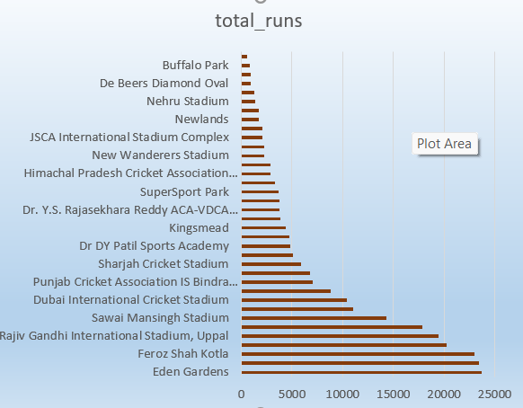
Answer 9
select venue,sum(total_runs) as total_runs
from deliveries_v03
group by venue
order by total_runs desc;

Slide 32
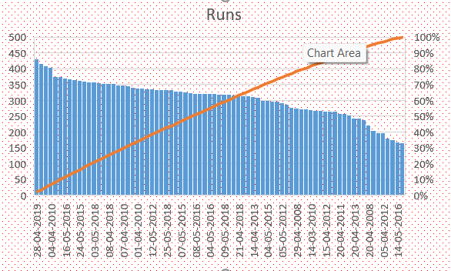
Answer 10
select match_date,sum(total_runs) as total_runs
from deliveries_v03
where venue='Eden Gardens'
group by match_date
order by total_runs desc;

Slide 33
THANK YOU!

